Slide 1
C programming
Prepared by:
Shrey P. Bechara
GID: 158312

Slide 2
What is programming? What is C? Some uses of C?

Slide 3
Compilation process and macro.
Compiler consist of Preprocessor, compiler, assembler & linker.
Macro:- A piece of code in a program, that is replaced by the value of a macro. It is defined by #define directive.
There are different types pf macro:- Object macro, Function macro, Multi-line macro and chain like macro.
For example:- #define a 5 #define AREA(l , b) (l * b)
#define ELE 1, \ #define INSTAGRAM FOLLOWERS
2, \ FOLLOWERS 138 (%dk)
3

Slide 4
Variables, Constants, Keywords(Volatile) & Identifiers
What is variable? Types of variable? Rules for declaring variable? Case sensitive
What is constant?
Keywords? There are 32 keywords in C. They are in lower case. Can’t be used as variable/array name. Meaning is already known to compiler.
Volatile keywords? Stored in static RAM.
Identifiers? user defined names of variables, functions and arrays. Rules for declaring Identifiers?

Slide 5
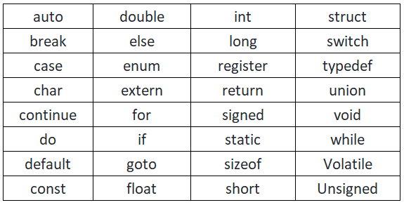

Slide 6
Instruction and operators
C program is a set of instruction given to computer to perform a specific task.
Types of instruction:-
1. Type declaration Instruction
2. Arithmetic Instruction
3. Control Instruction
Operator precedence & associativity in Arithmetic e.g. 3x-8y.
Control Instruction:- decision control(If/else and switch), conditional operator, loop control(break,continue).
Types of Operators and its precedence:- Arithmetic, logical, relational, bitwise operator.

Slide 7
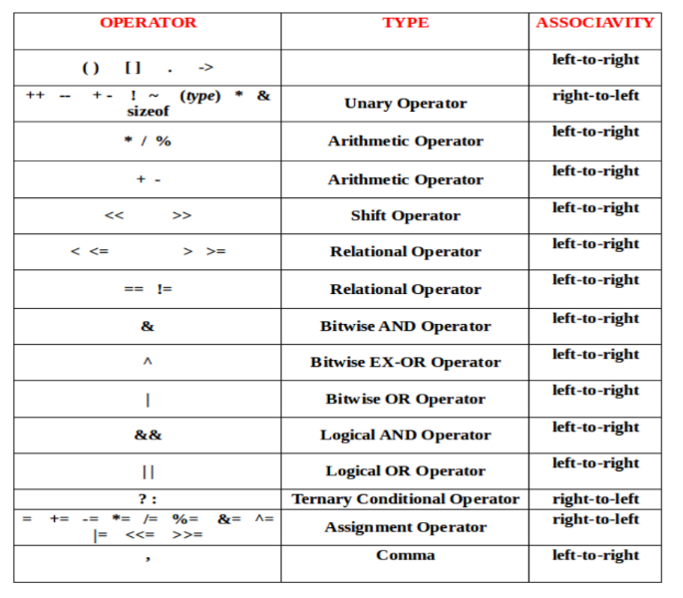

Slide 8
Functions and recursion
Function declaration?
Function definition ?
Function call?
Function datatype(int, float and void)?
Call by value?
Call by reference?
What is Recursion?

Slide 9
Pointers
What is pointer?
Why Pointers?
C uses pointers to create dynamic data structures, data structures built up from blocks of memory allocated from the heap at run-time. Example linked list etc.
C uses pointers to handle variable parameters passed to functions.
Pointer use in system level programming where memory addresses are useful. For example shared memory used by multiple threads.
Pointers are used for file handling.
Pointer to pointer(Double pointer)?
Array of Pointer, Pointer and Function(call by value, call by reference)

Slide 10
Arrays
Accessing array using pointer.
Passing arrays to function.(function call, function prototype)
Multidimensional array.
Memory allocation of array

Slide 11
String
Puts
Gets
Declaring string using pointer (reinitialize is possible)
Strlen(str), strcpy(target, source), strcat(s1, s2), strcmp(“for”, “joke”)
Memory allocation of string

Slide 12
Structure and union
Typedef
Pointer and structure & union

Slide 13
Storage classes & Memory segment
Variable are of 4 types:-
Auto , Register , Static and extern.
Scope?
Lifetime?
Where?
Default value?
Memory segment:- Stack, heap, static

Slide 14
File i/o
FILE pointer
fclose(ptr)
fgetc(ptr)
fputc(‘c’, ptr)
EOF

Slide 15
Dynamic memory allocation
malloc()
calloc()- default value, continuous memory allocation, null pointer
realloc()
free()

Slide 16
Thank you

